Slide 1
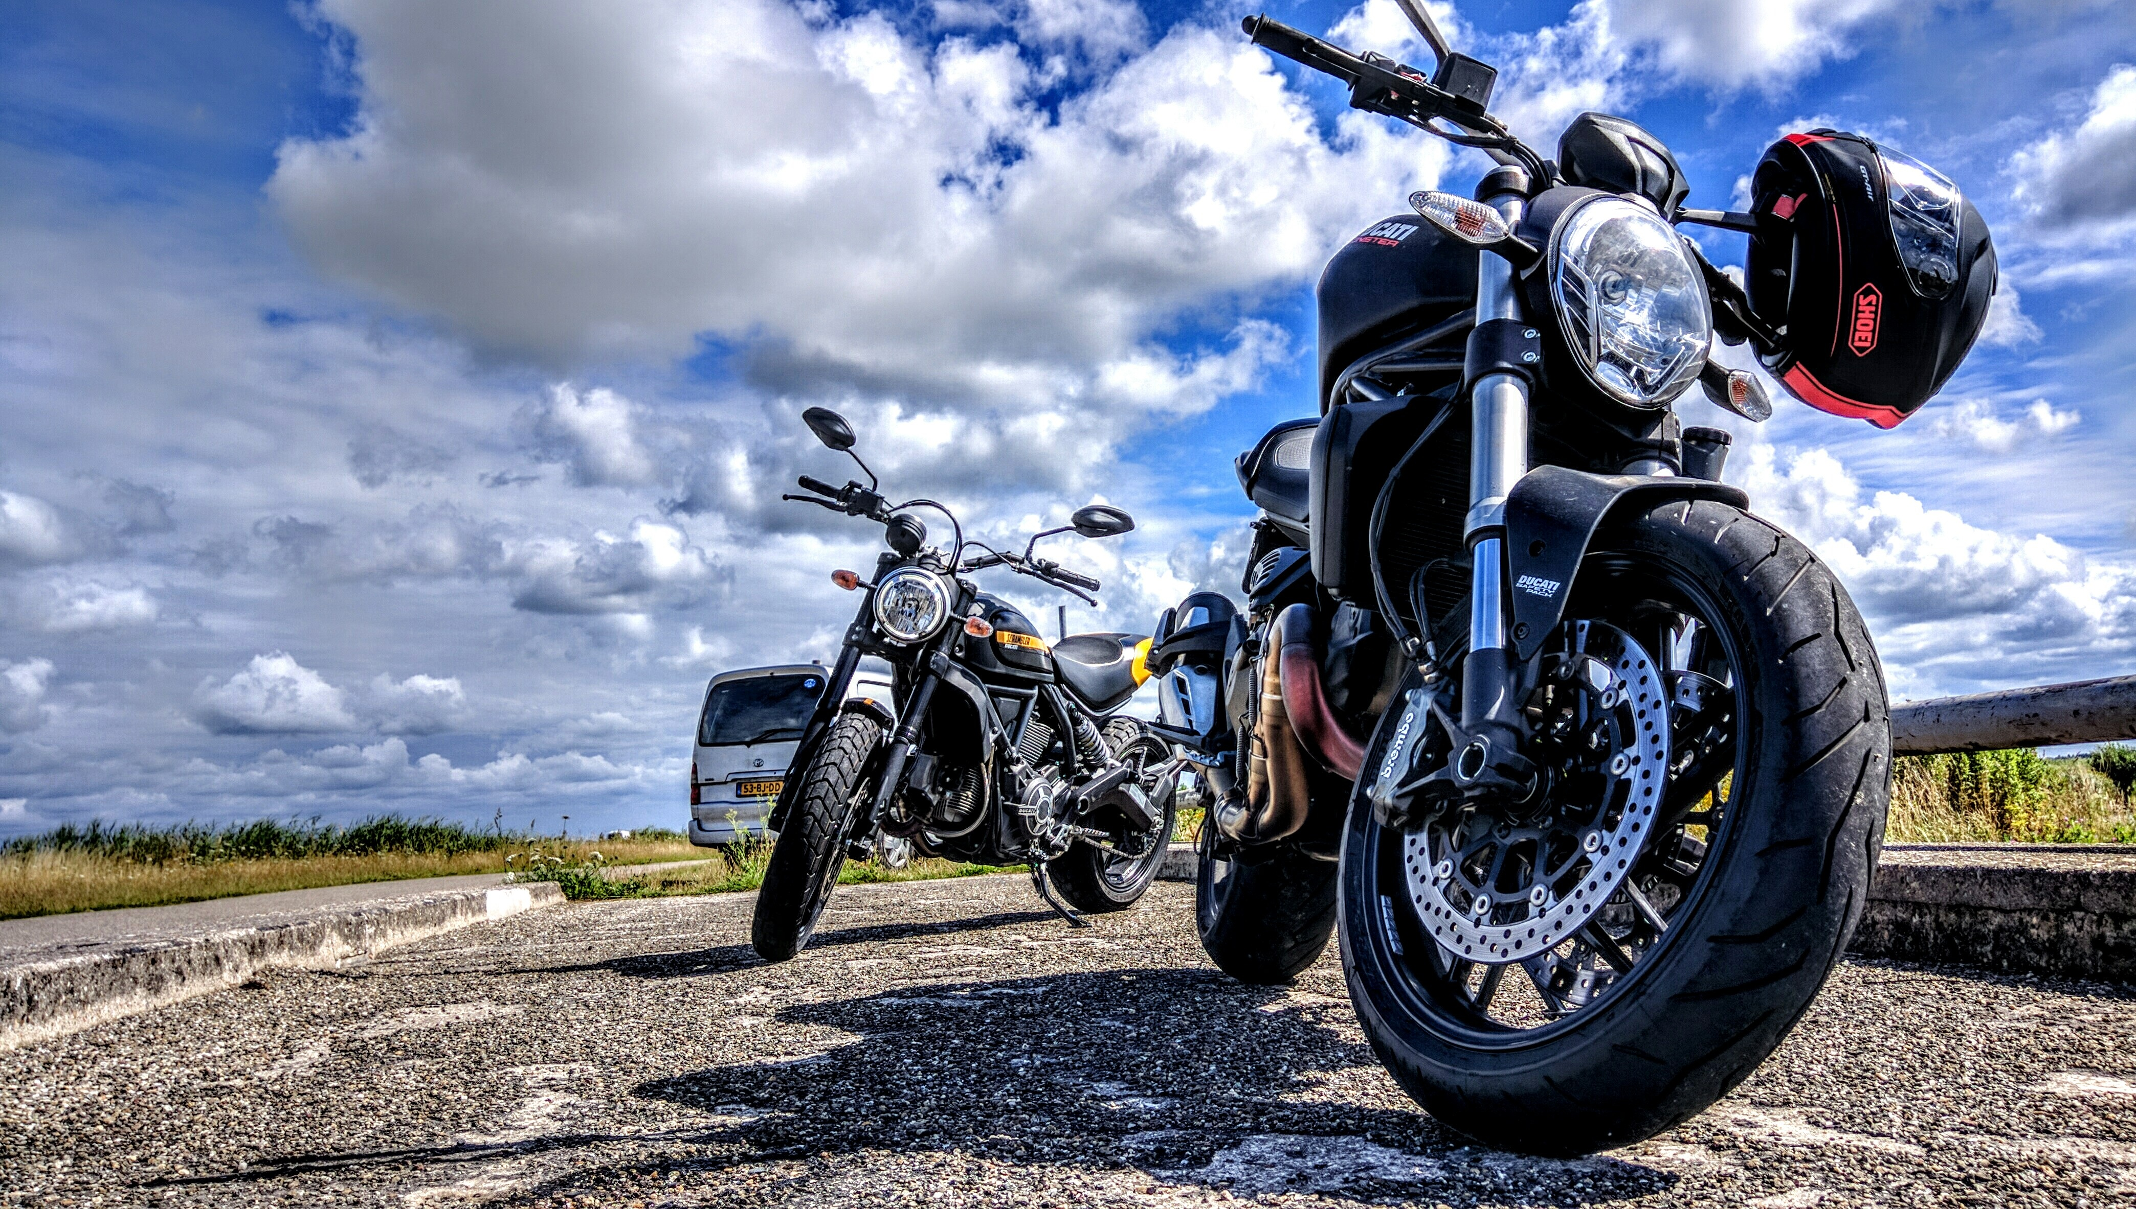
Bike Preference Trends in India – 2025
A Data-Driven Look at Ratings, Reviews & Performance

Slide 2
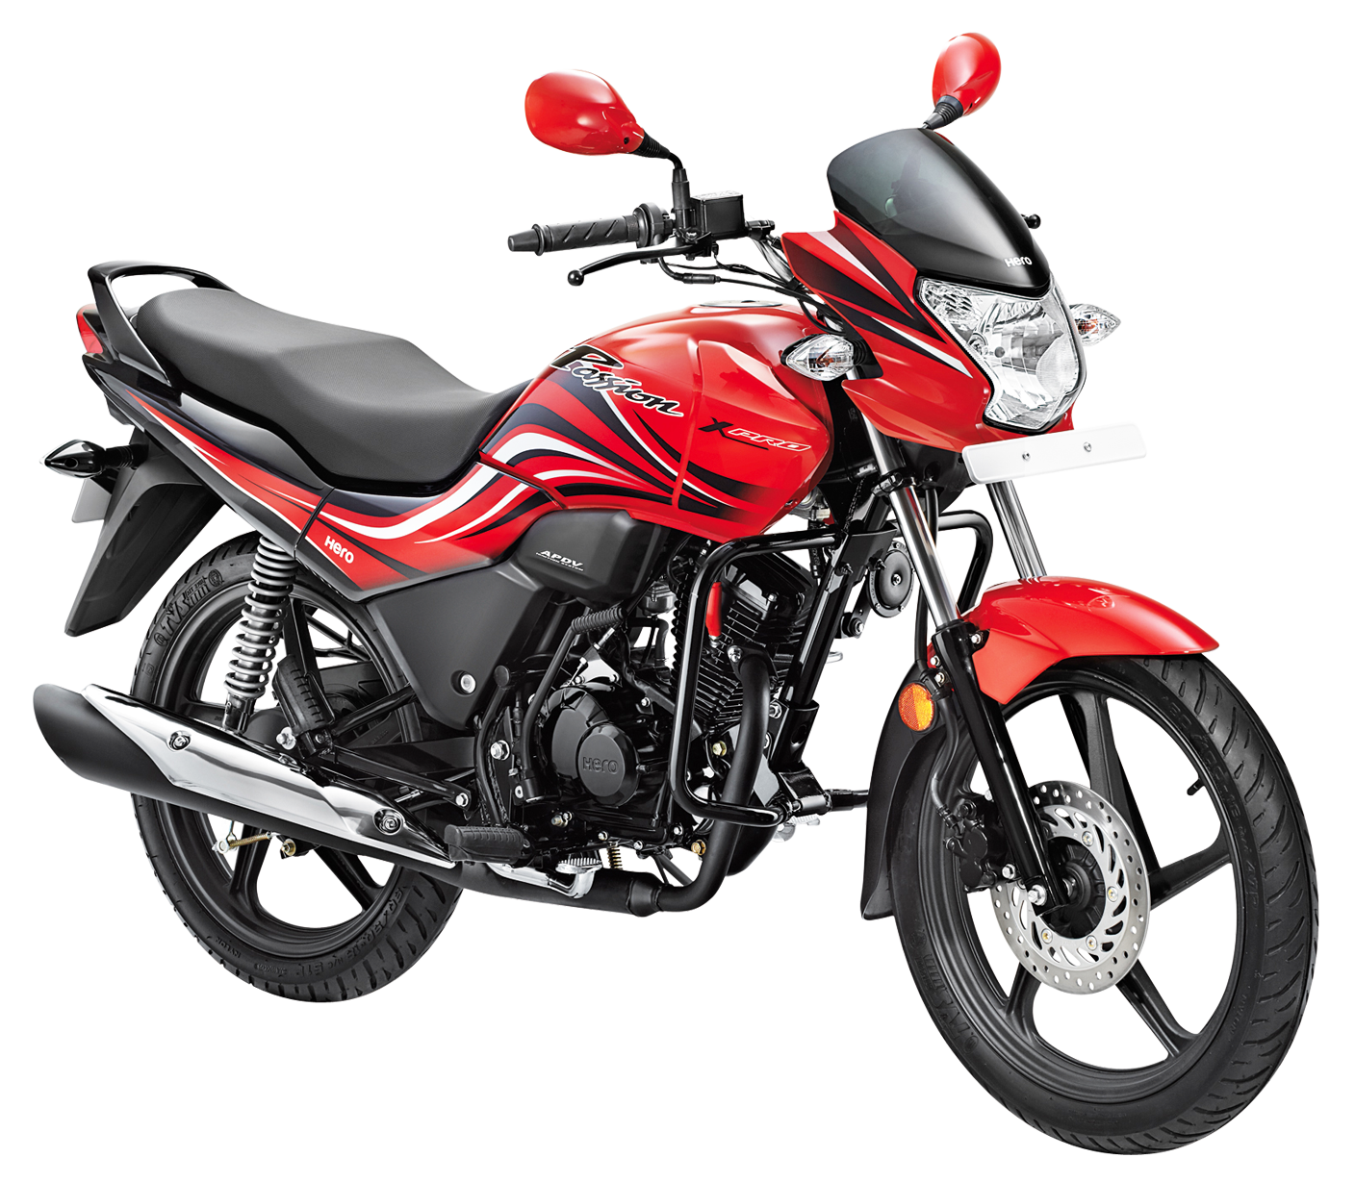
Agenda
Overview of Bike Market in India
User Ratings by Brand
Engine Capacity vs Price
Top 20 Purchased Bikes
Top 10 Preferred Bikes by Ratings
Insights & Recommendations

Slide 3
Indian Bike Market Overview
India has a highly diverse bike market.
Consumer preferences are influenced by:
- Affordability
- Brand Trust
- Mileage & Maintenance
- Style & Performance

Slide 4
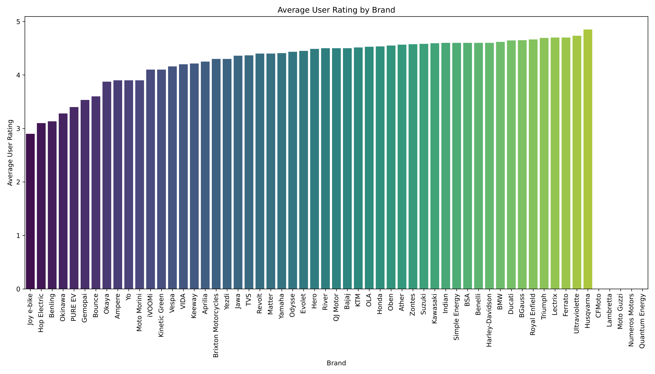
Average User Rating by Brand
Some brands (e.g., Royal Enfield, Yamaha) consistently score higher.
E-bike and electric segments show growing user satisfaction.

Slide 5
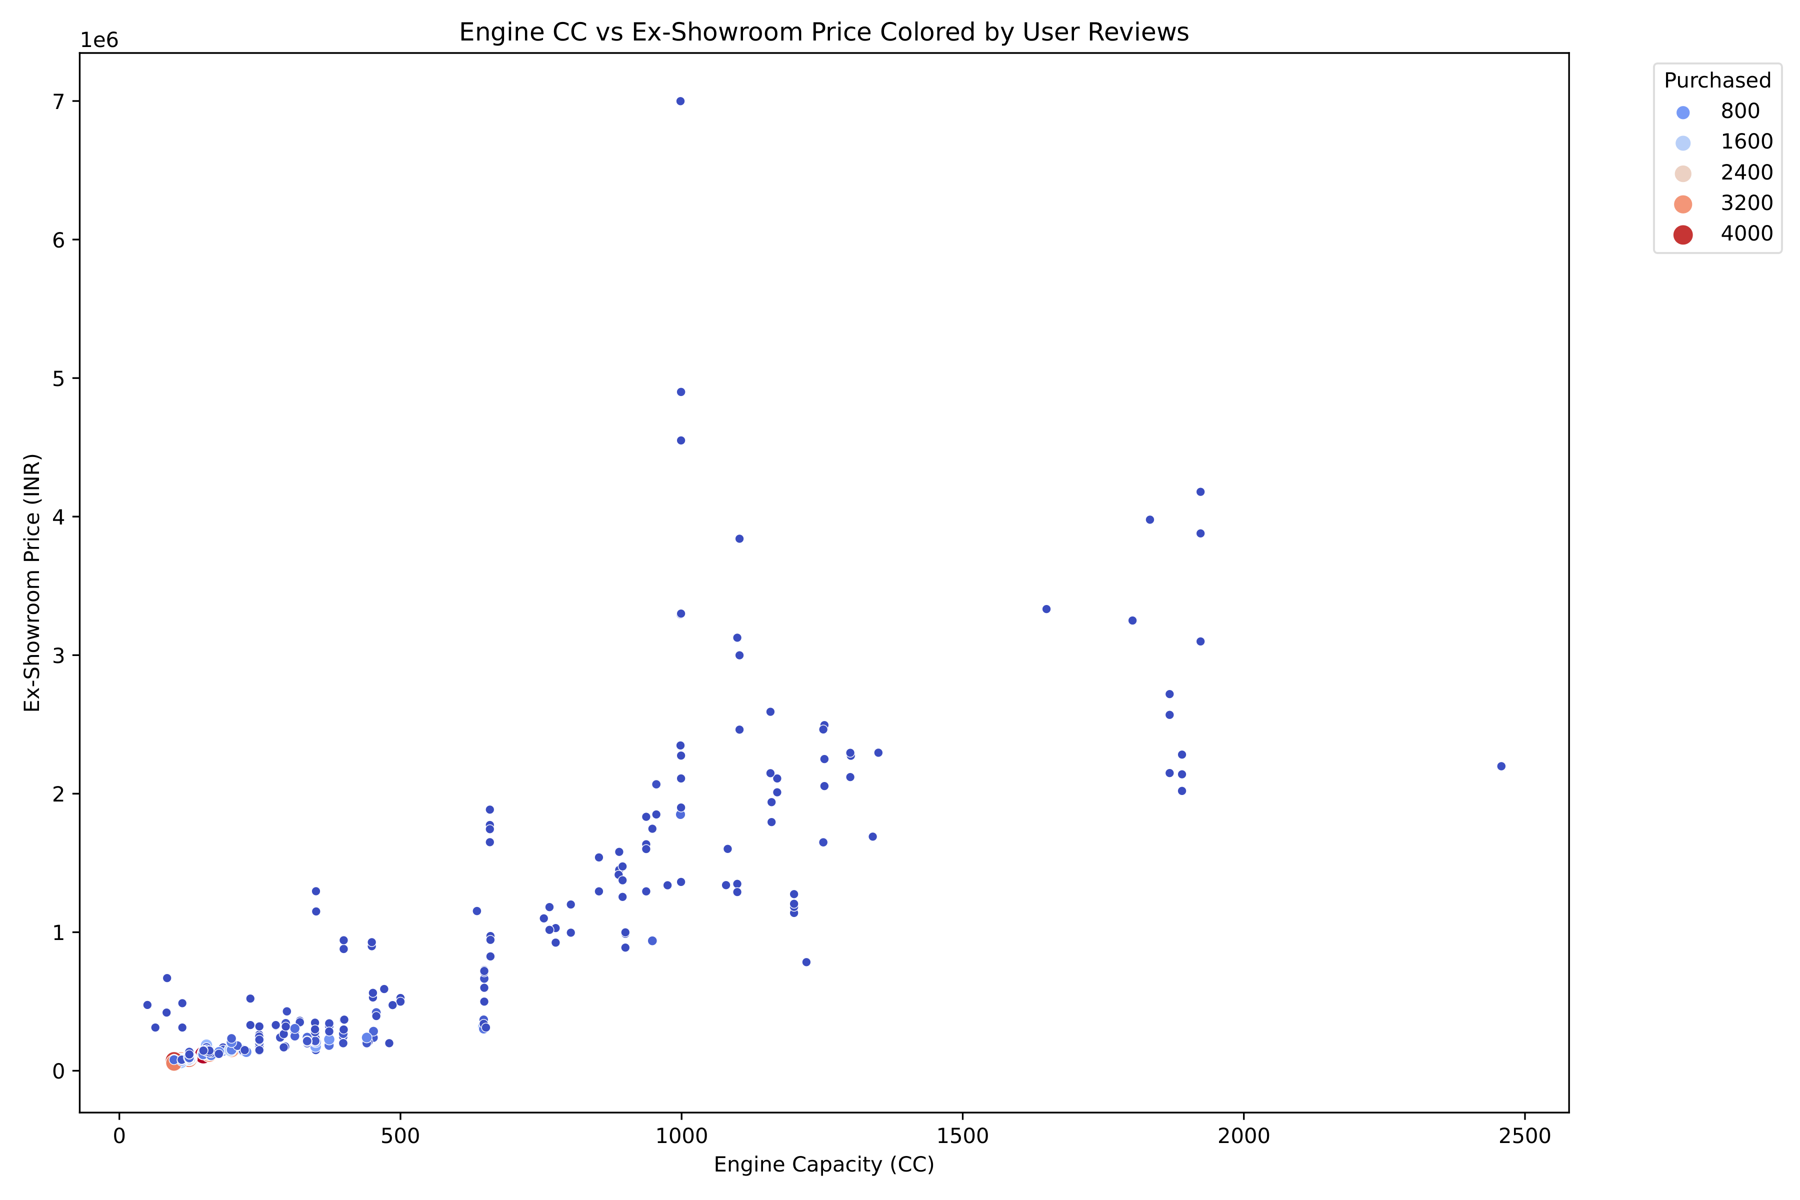
Engine Capacity vs Ex-Showroom Price
Clear price jump as engine capacity increases.
Some high-CC bikes have fewer reviews, suggesting niche appeal.
Value for money bikes cluster around 100-150cc range.

Slide 6
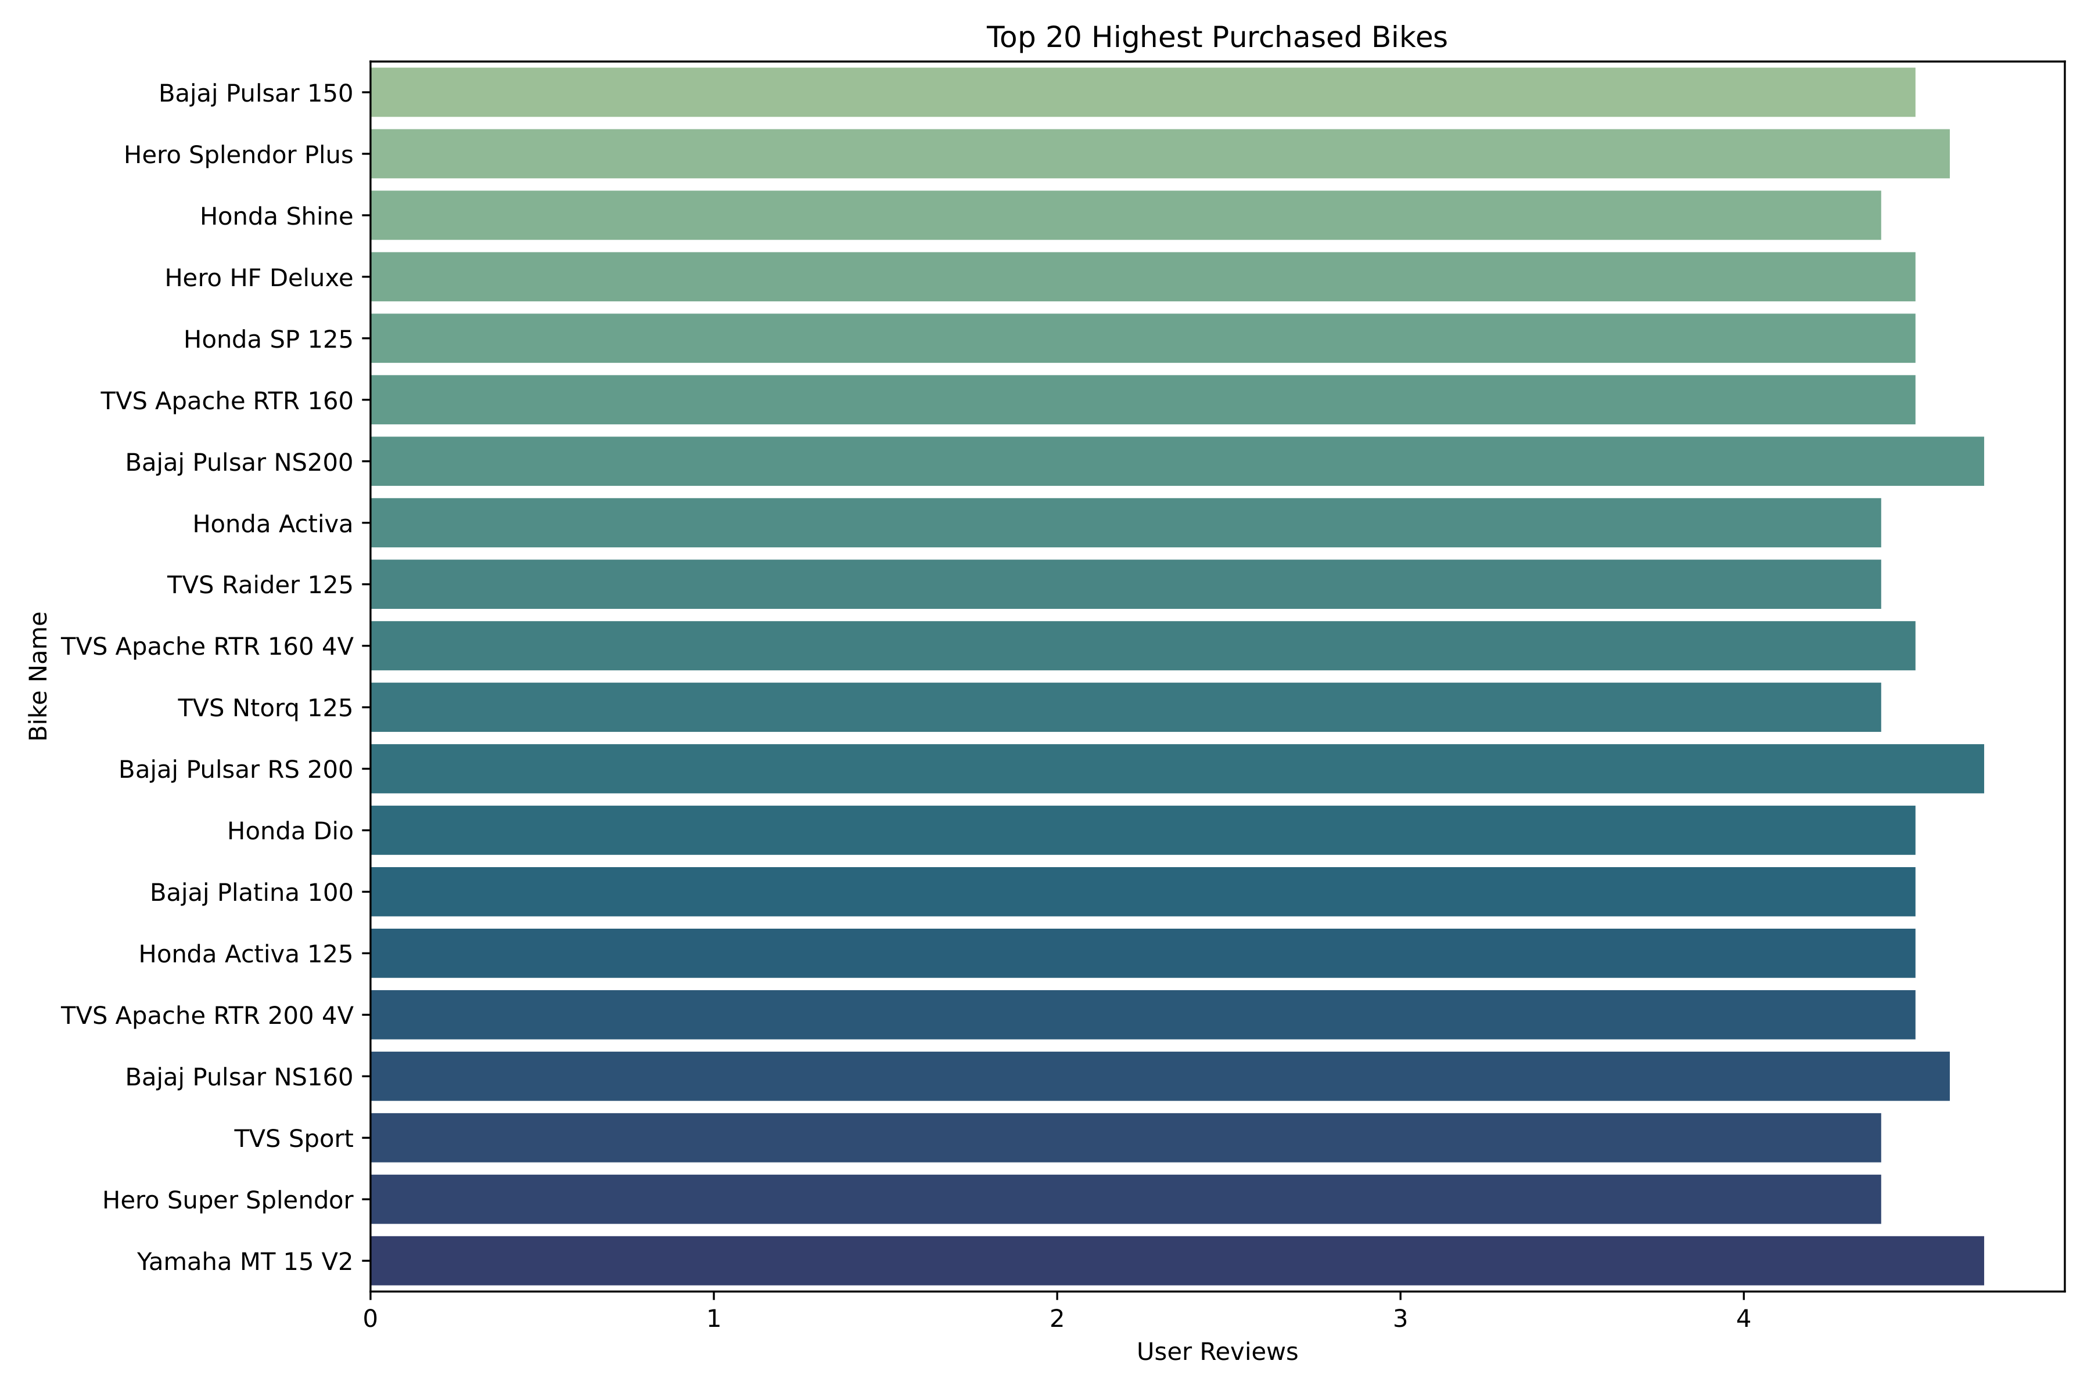
Top 20 Highest Purchased Bikes
Bajaj, Hero, Honda, and TVS dominate.
Top 5 include:
Bajaj Pulsar 150
Hero Splendor Plus
Honda Shine
Hero HF Deluxe
Honda SP 125.

Slide 7
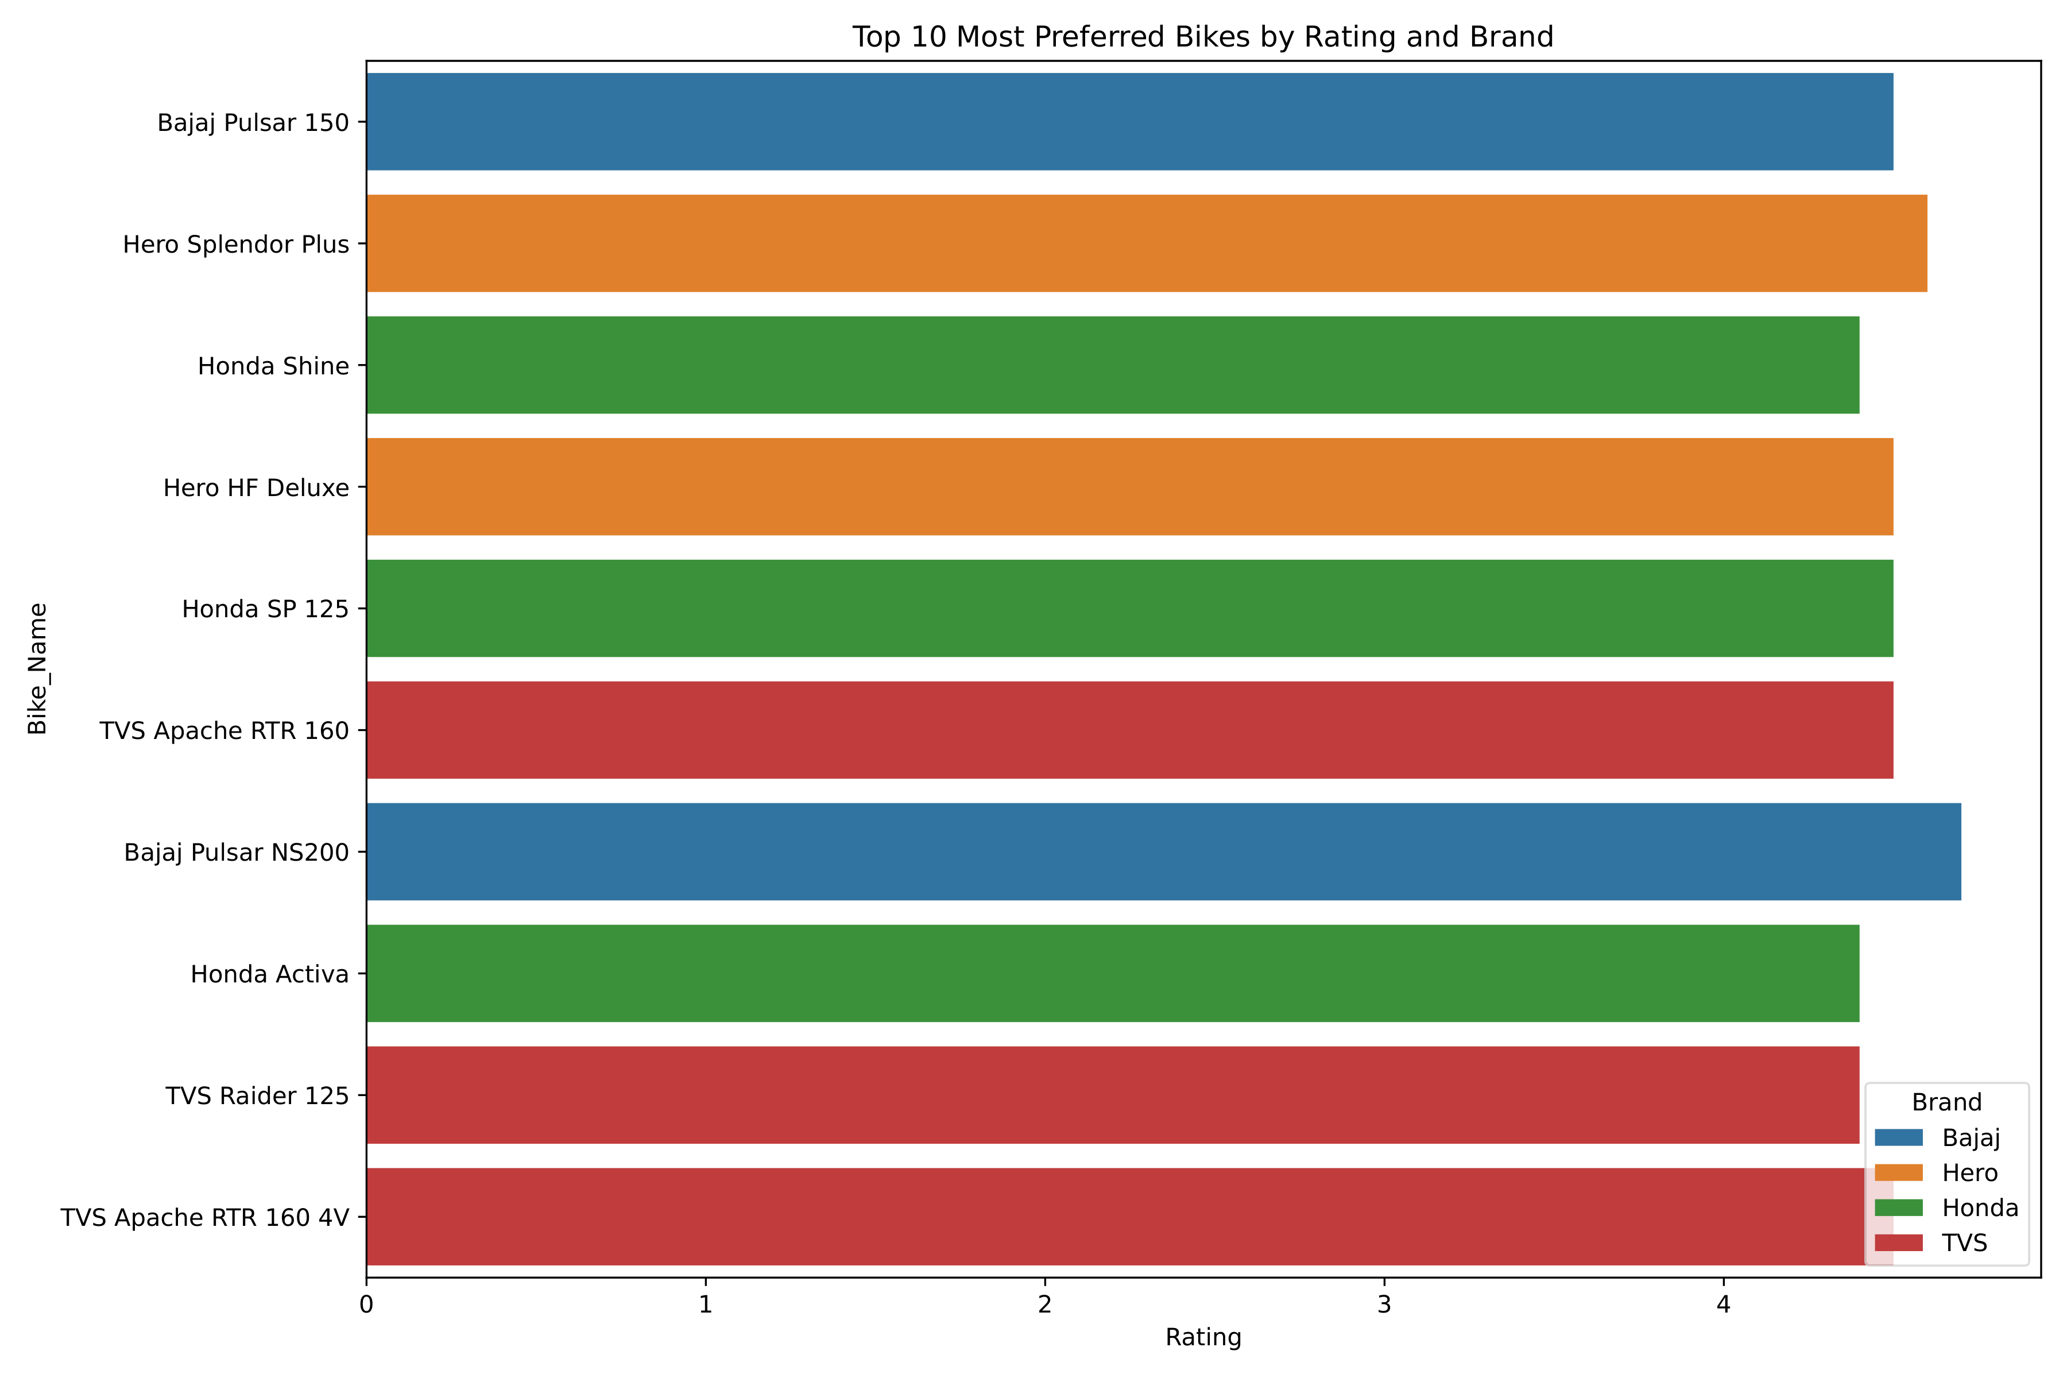
Top 10 Preferred Bikes by Rating
Focus on ratings instead of volume.
Bajaj and TVS lead in user satisfaction.

Slide 8
Key Insights
Users highly rate performance bikes in the 150–200cc range.
Hero and Honda dominate in overall sales.
Bajaj and TVS lead in popularity and satisfaction.
Electric bikes gaining traction, but adoption still growing.

Slide 9
Recommendations
Dealerships should promote high-rated mid-range models.
Manufacturers can enhance visibility of low-reviewed models.
Invest in electric vehicle (EV) education to boost sales.

Slide 10

Q&A
Any Questions?
Let's discuss how these trends affect your buying or selling strategy.

